Slide 1

Research Impact Support
Martha Earl, MSLS
August 11, 2020

Slide 2
Guidance for the Assessment of Publication Productivity by GSM AAPTC
The new guidelines focus upon evaluation of the following metrics of productivity, which will be requested from the faculty member at the time of application:
1. The h-index of the applicant (which can be obtained from staff at the Preston Medical Library) will be determined by the higher of the Scopus and Web of Science indices.
2. Total number of peer-reviewed publications.
3. The applicant’s position in the author list and journal impact factor for each peer-reviewed publication over the last 5 years (the “5-y Power” score).

Slide 3
Guidance for the Assessment of Publication Productivity by GSM AAPTC
Only publications cited in PubMed with an impact factor of 1.00 or greater will be used in the calculations.

Slide 4
Guidance for the Assessment of Publication Productivity by GSM AAPTC

Slide 5
Guidance for the Assessment of Publication Productivity by GSM AAPTC
The metric for non-tenure clinician and teachers was derived by estimating ~2/3 of the requirement of research faculty in accordance with UTHSC-Memphis values for faculty h-index data.
The 5-y Power score is calculated by multiplying the impact factor of the journal (at the current time, which can be obtained at scijournal.org) by 2 for first or last author placement, and by 1 for any other author place. The Power score is determined for the previous 5 years.
Journal Citation Reports is preferable for finding the journal impact factors. Scopus is preferable for finding author h-index.

Slide 6
Guidance for the Assessment of Publication Productivity by GSM AAPTC
Assistance with all aspects of data gathering to complete this new series of metrics can be obtained from the Preston Medical Library/Health Information Center faculty.
Call 305-9525 or email library@utmck.edu.

Slide 7
Evaluation of Publication Productivity
Publications (specify number) | First Author | Last Author | Co-Author | Total Number
Number of peer-reviewed manuscripts (original communications only; PubMed cited; IF ≥1)
Number of peer-reviewed case reports, reviews, and similar communications (PubMed cited; IF ≥1)
Total number of peer-reviewed manuscripts published (PubMed cited; IF > 1)
Number of all manuscripts published
Number of manuscripts in press
Number of manuscripts submitted or in revision
Number of book chapters
All publications beginning with your undergraduate years.
Published abstracts do not count.
Explain books and media in the narrative.

Slide 8
5- Year Power Scoring Table for Peer-Reviewed Publications (PubMed cited; IF ≥1)
Original Research Publication title | Journal | Year | Current Impact Factor [scijournal.org] | First, Last, Co-author¹ | Score²
 |  |  |  | Subtotal
All other Communications Publication title | Journal | Year | Current Impact Factor [scijournal.org] | First, Last, Co-author¹ | Score²
 |  |  |  | Total
Only journals from the last 5 years that are indexed in PubMed and have an impact factor of greater than or equal to one. 2015-2020

Slide 9
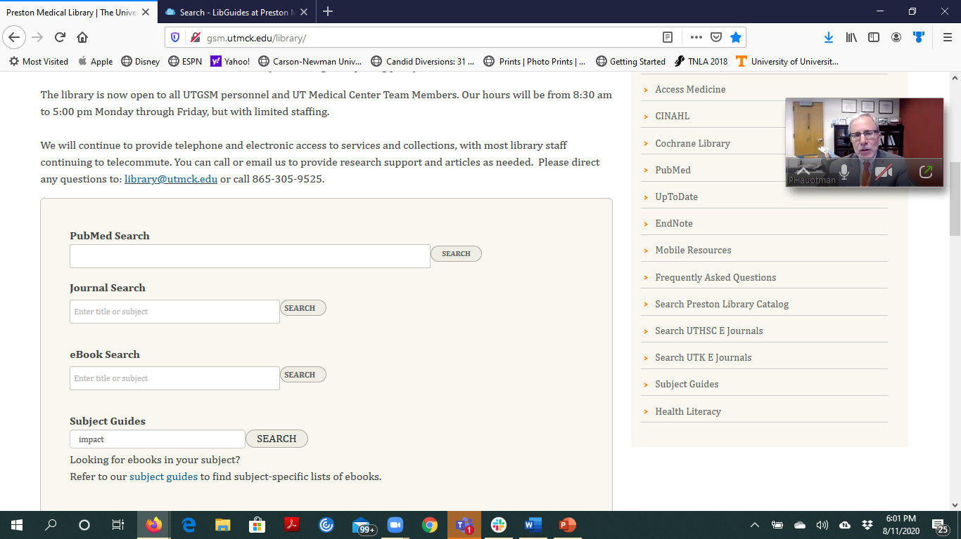
Type “impact” into the Subject Guides search box.

Slide 10
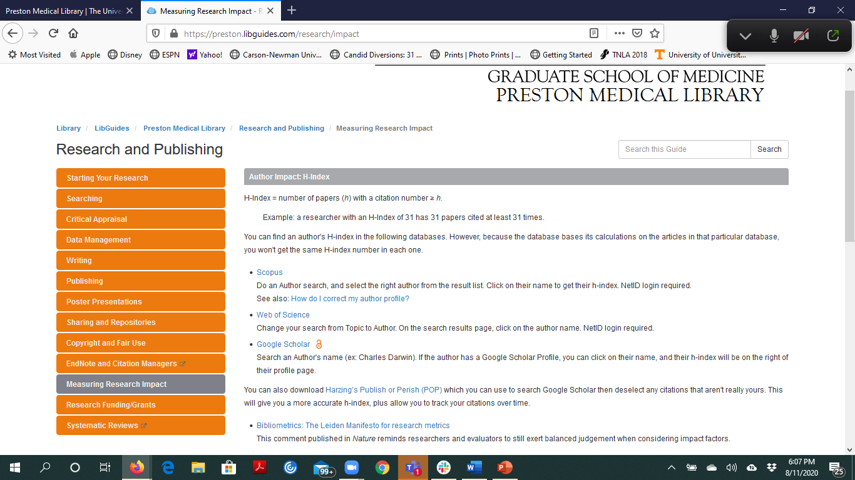
https://preston.libguides.com/research/impact
Use Scopus or Web of Science to find your current h-index. The h-index cannot go down in value.
Only your h-index from one of those databases will count. Or you may calculate your own using the Hirsch equation. https://en.wikipedia.org/wiki/H-index

Slide 11
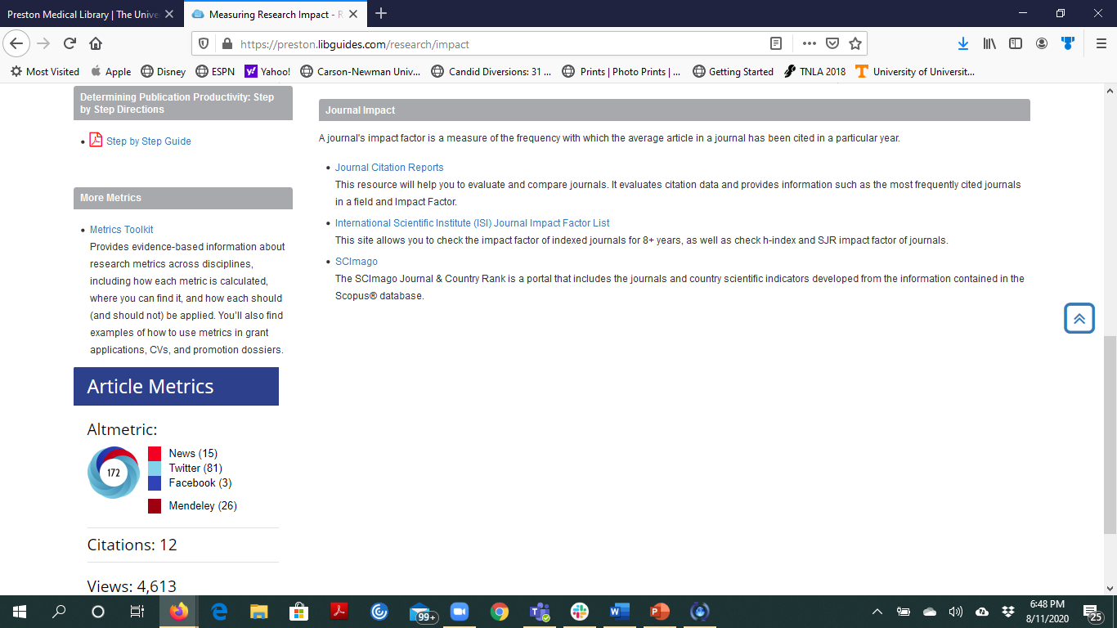
https://preston.libguides.com/research/impact
Use Journal Citation Reports first to look for the journal impact factor. Use the most current year’s impact factor.
Use SCImago if you cannot find the impact factor in JCR.
Note the useful Step by Step Guide.

Slide 12


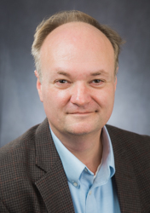


Ask your Preston library faculty colleagues.
Martha Earl, Kelsey Grabeel, Michael Lindsay, David Petersen, Alexandra Quesenberry

